Slide 1



Slide 2
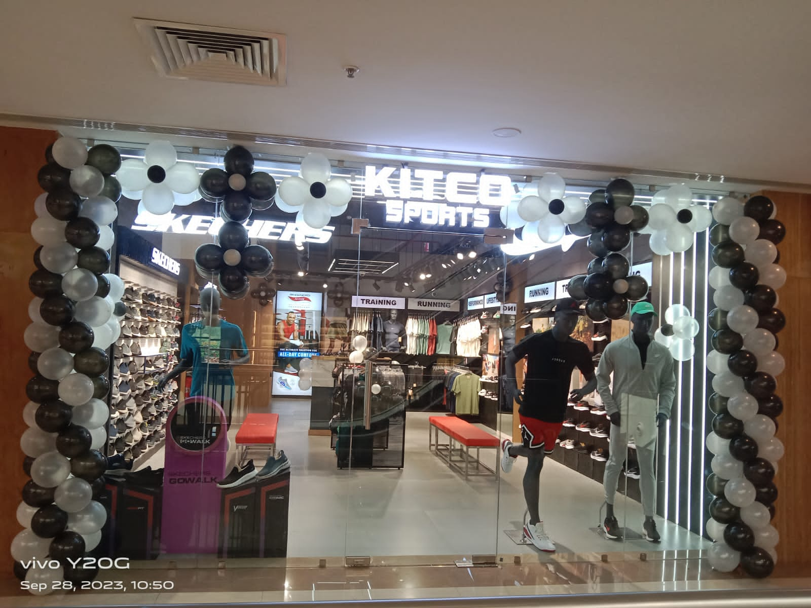
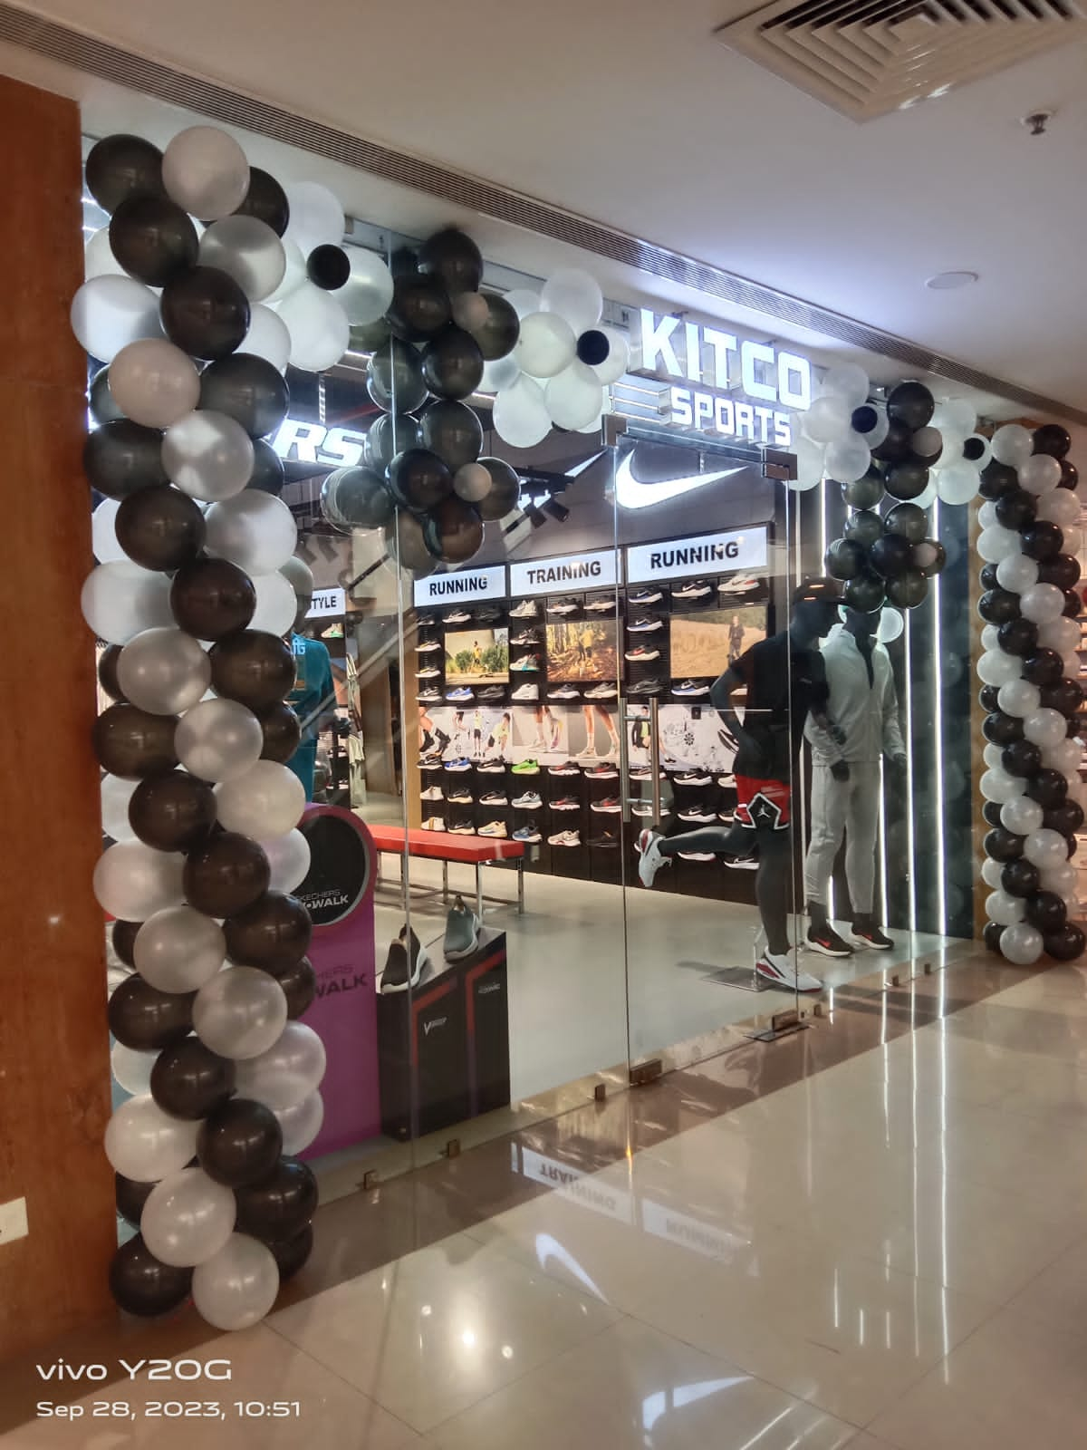
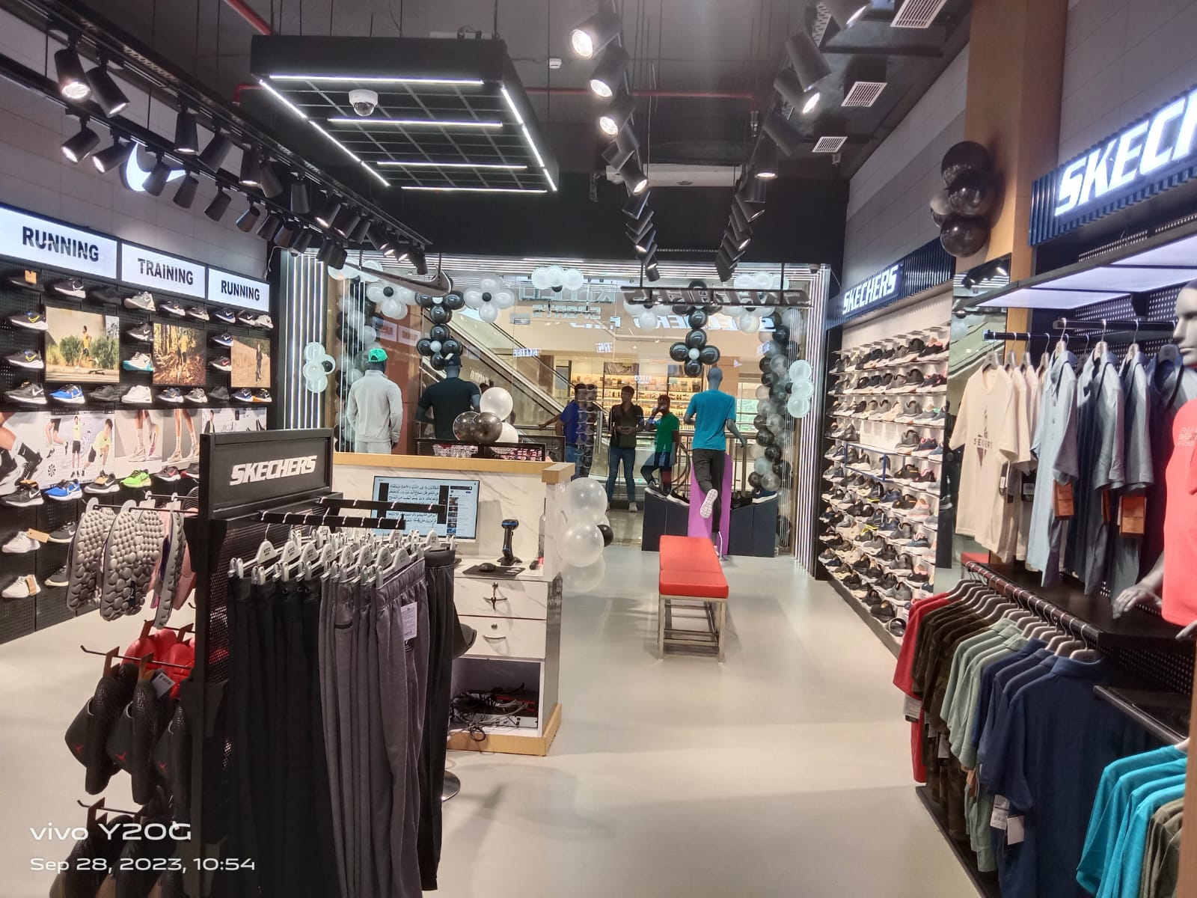
PNM Mall, Muzaffarpur

Slide 3
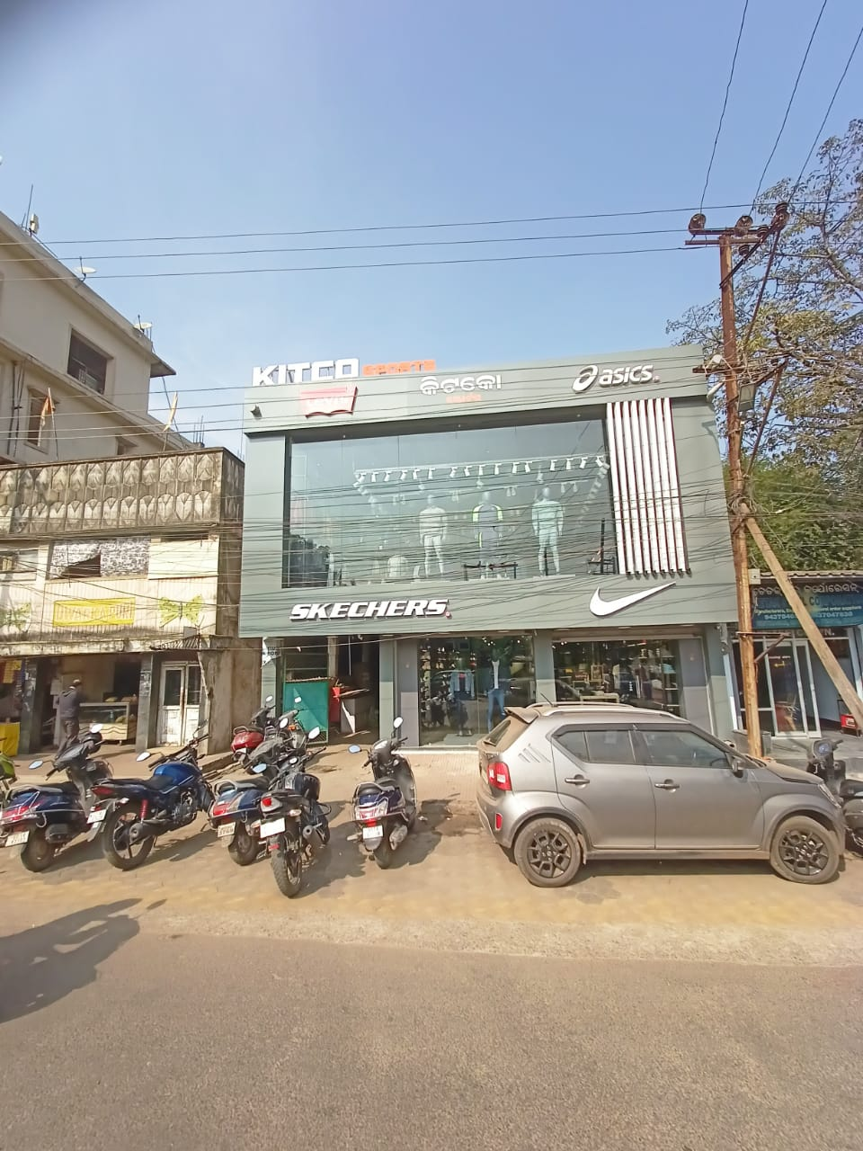
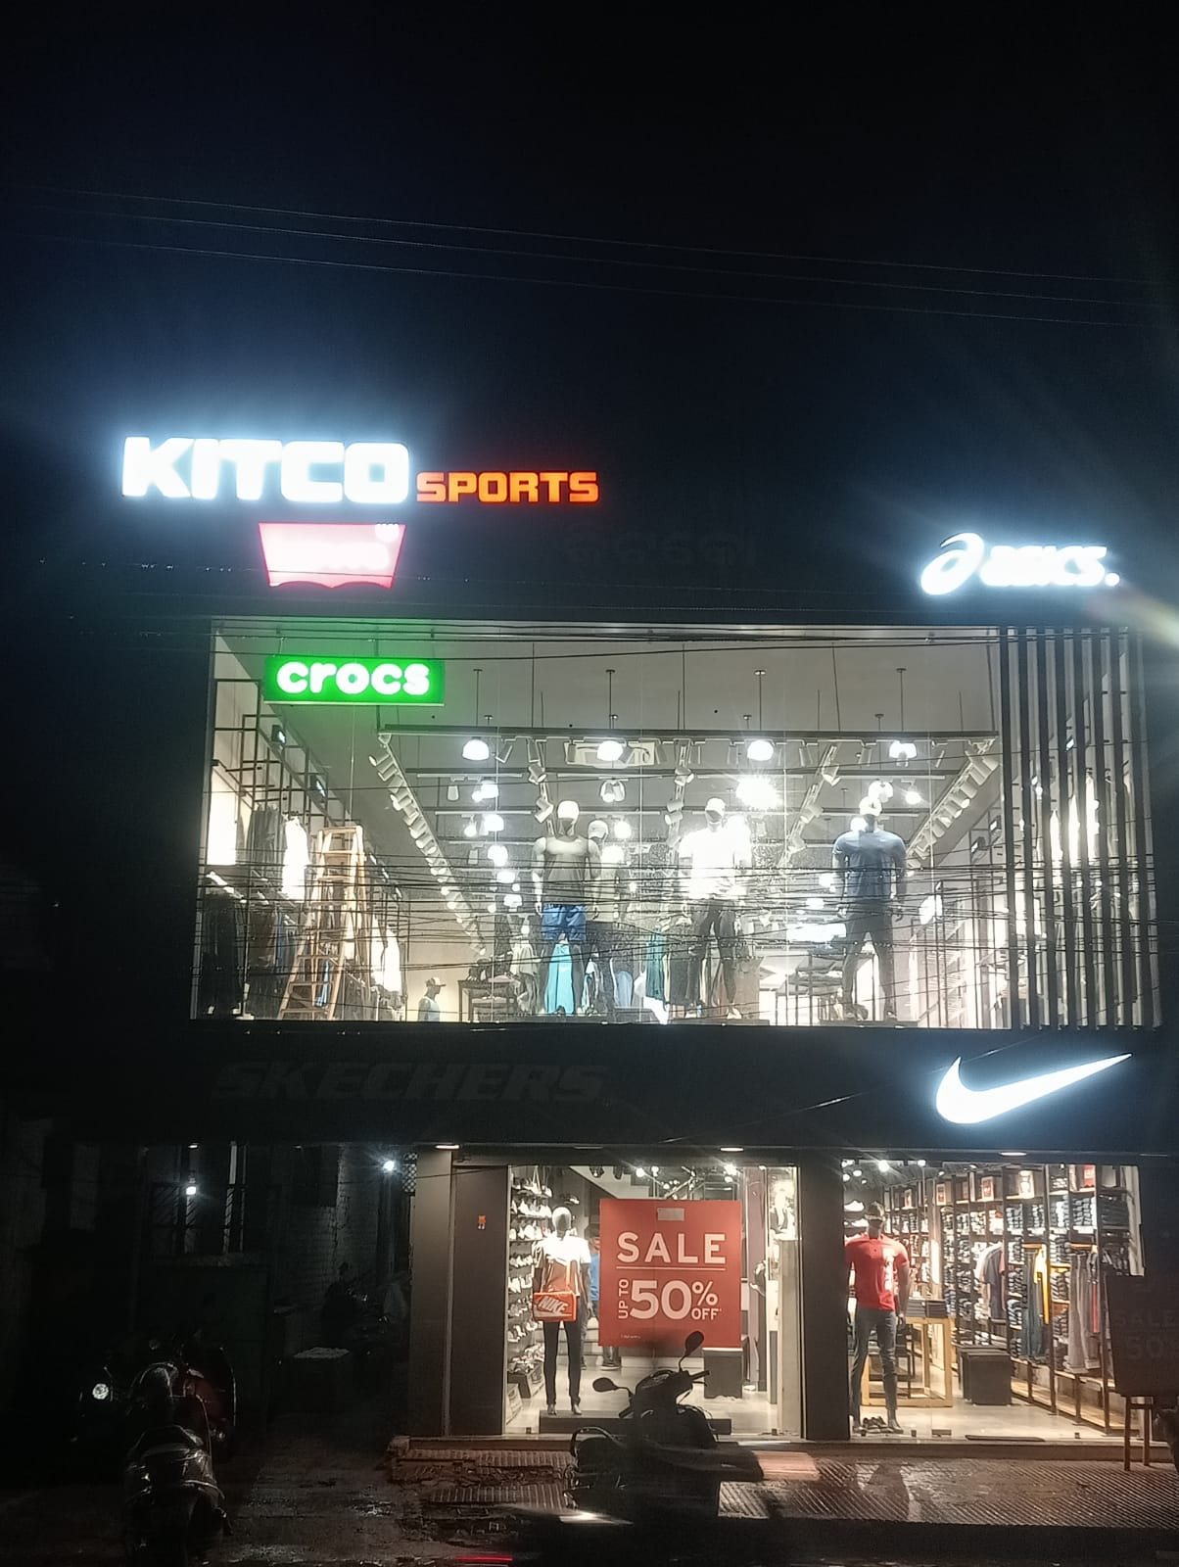
Rourkela - Udit Nagar

Slide 4
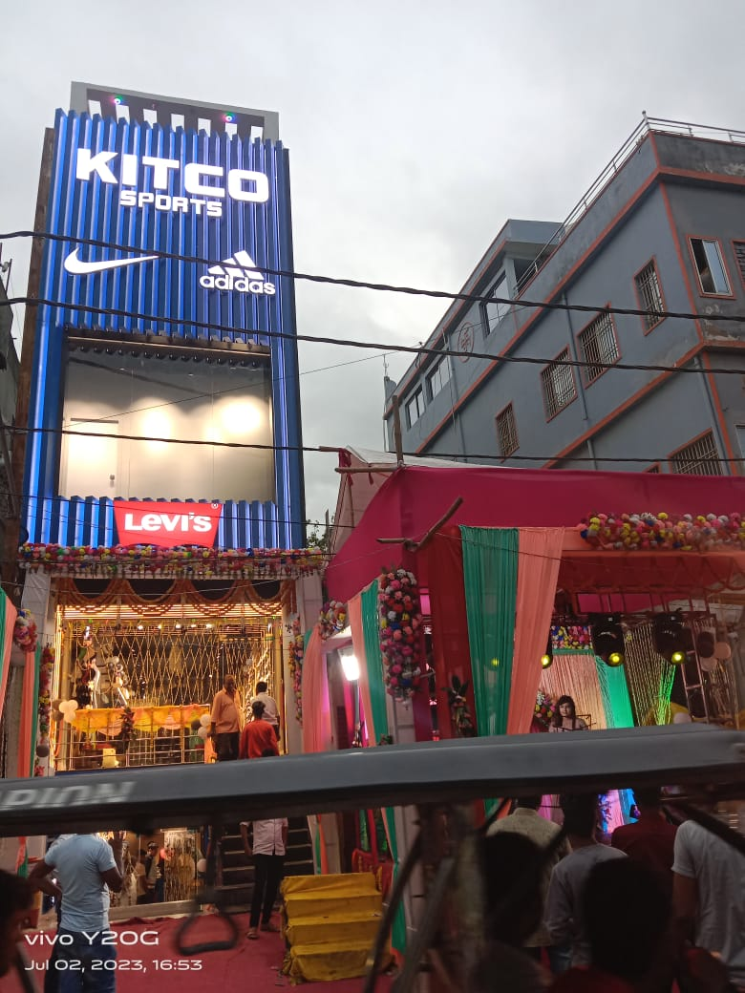
KITCO SPORTS-Bihar Sharif

Slide 5
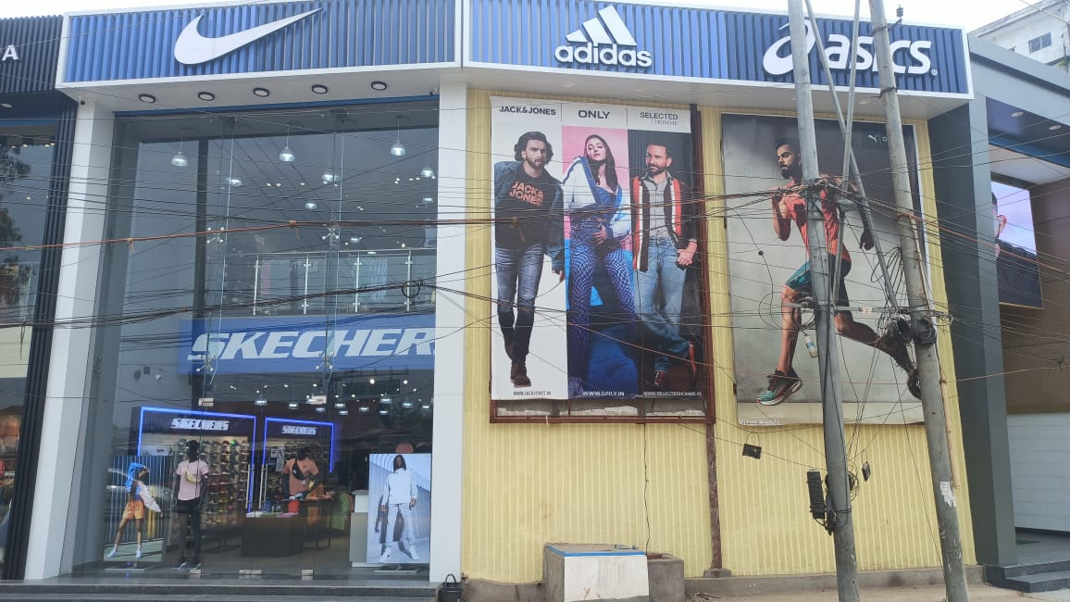
Dimapur

Slide 6
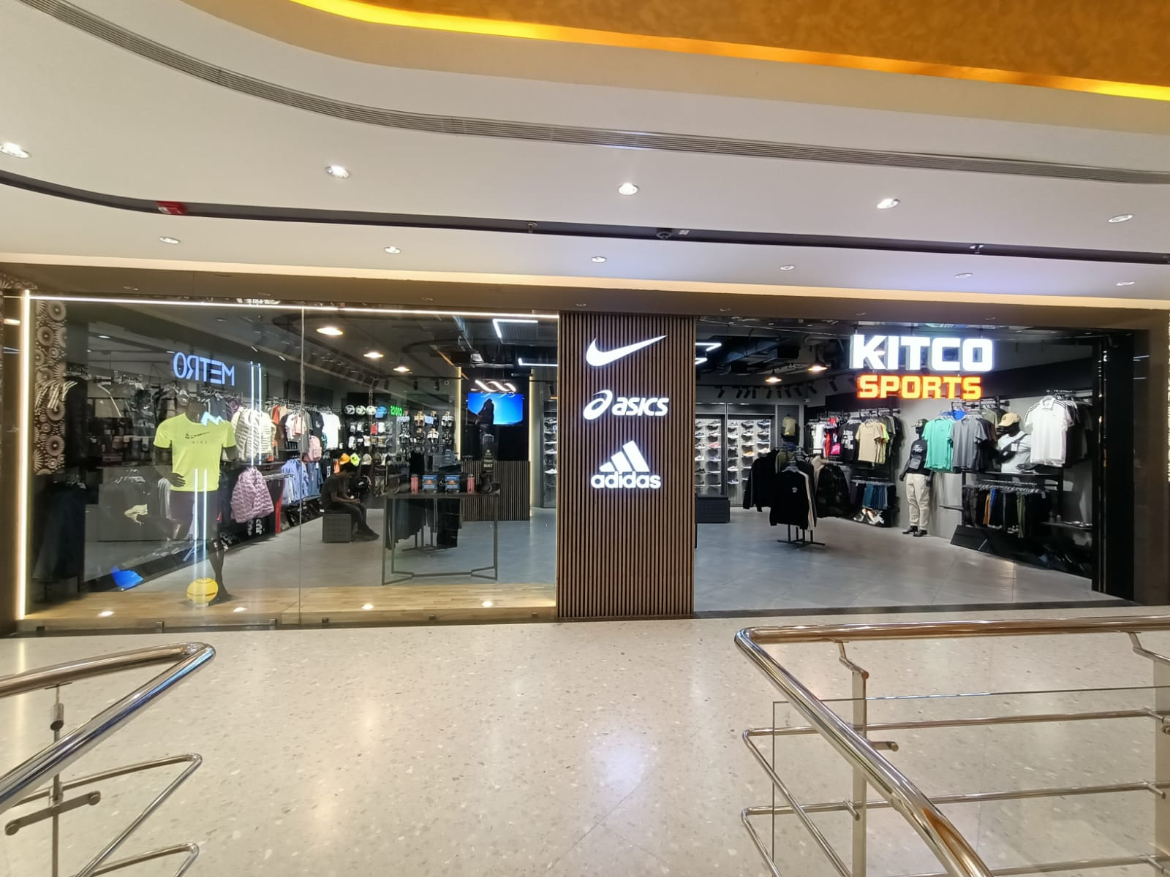
KITCO SILIGURI ML ACROPOLIS
VIEW- Store Entrance

Slide 7
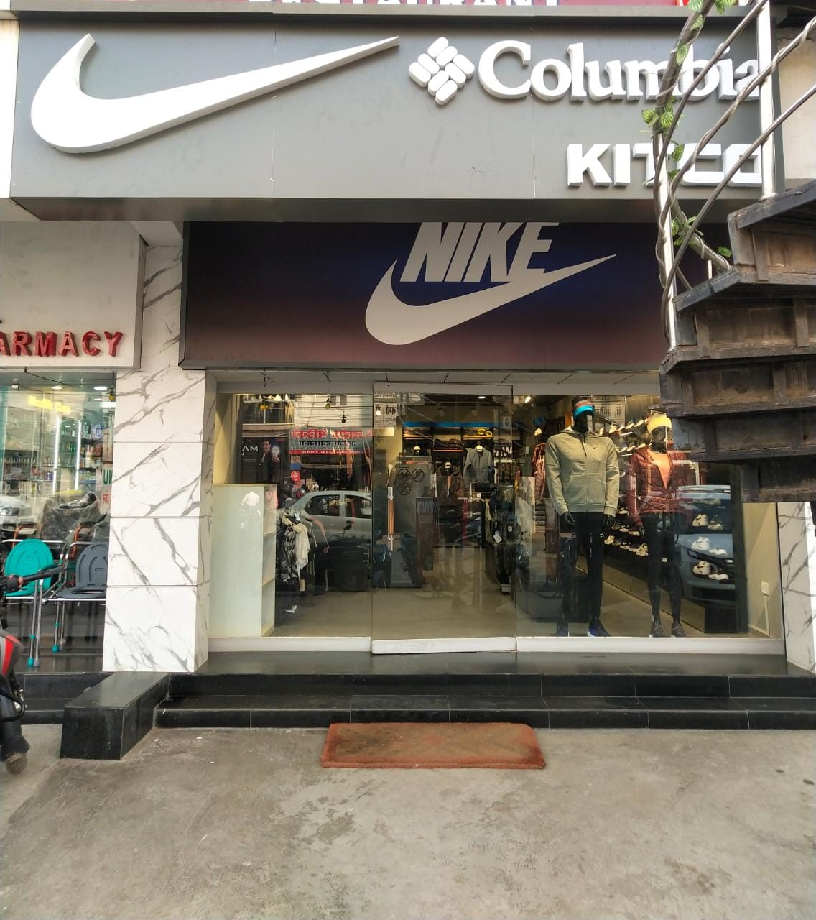
Kankarbagh - Patna

Slide 8
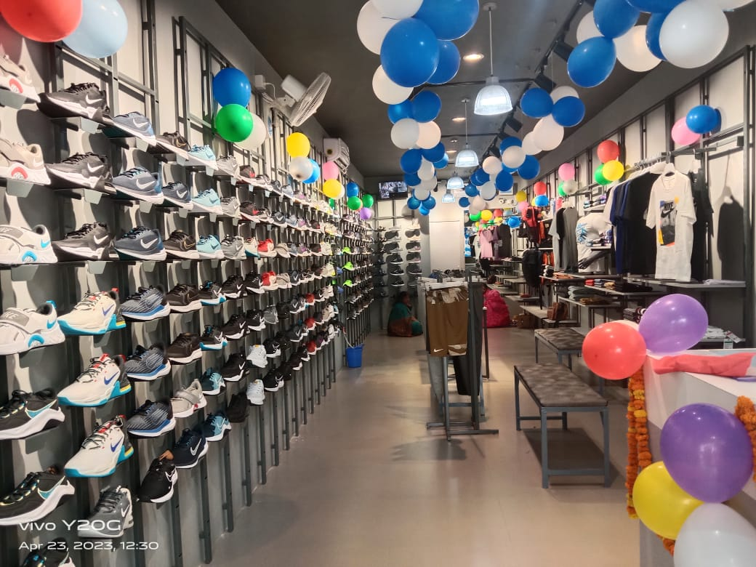
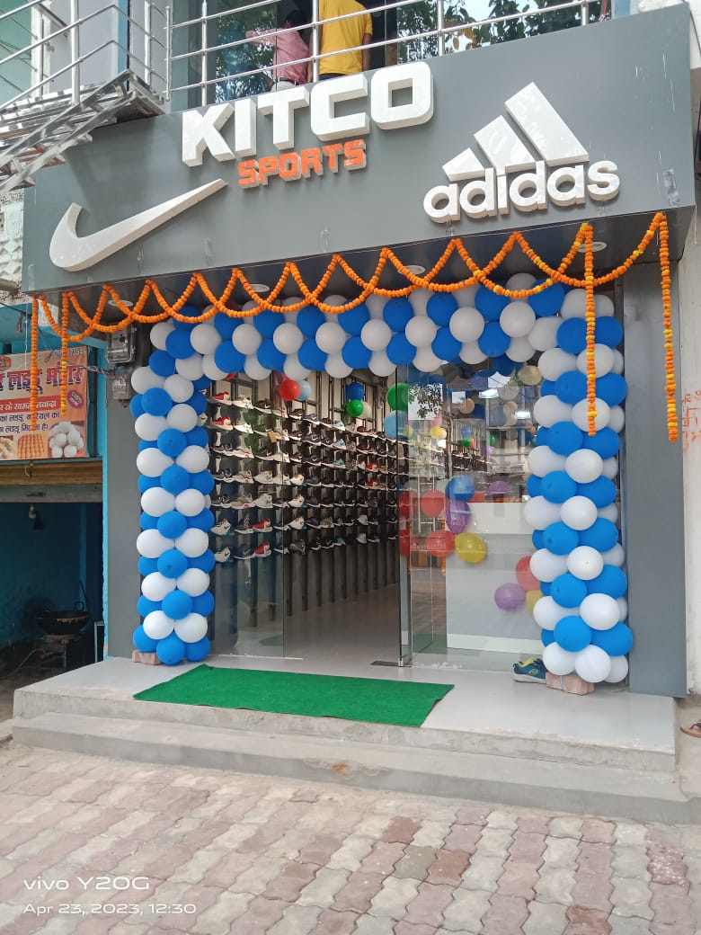
KITCO-Nawada, Bihar

Slide 9
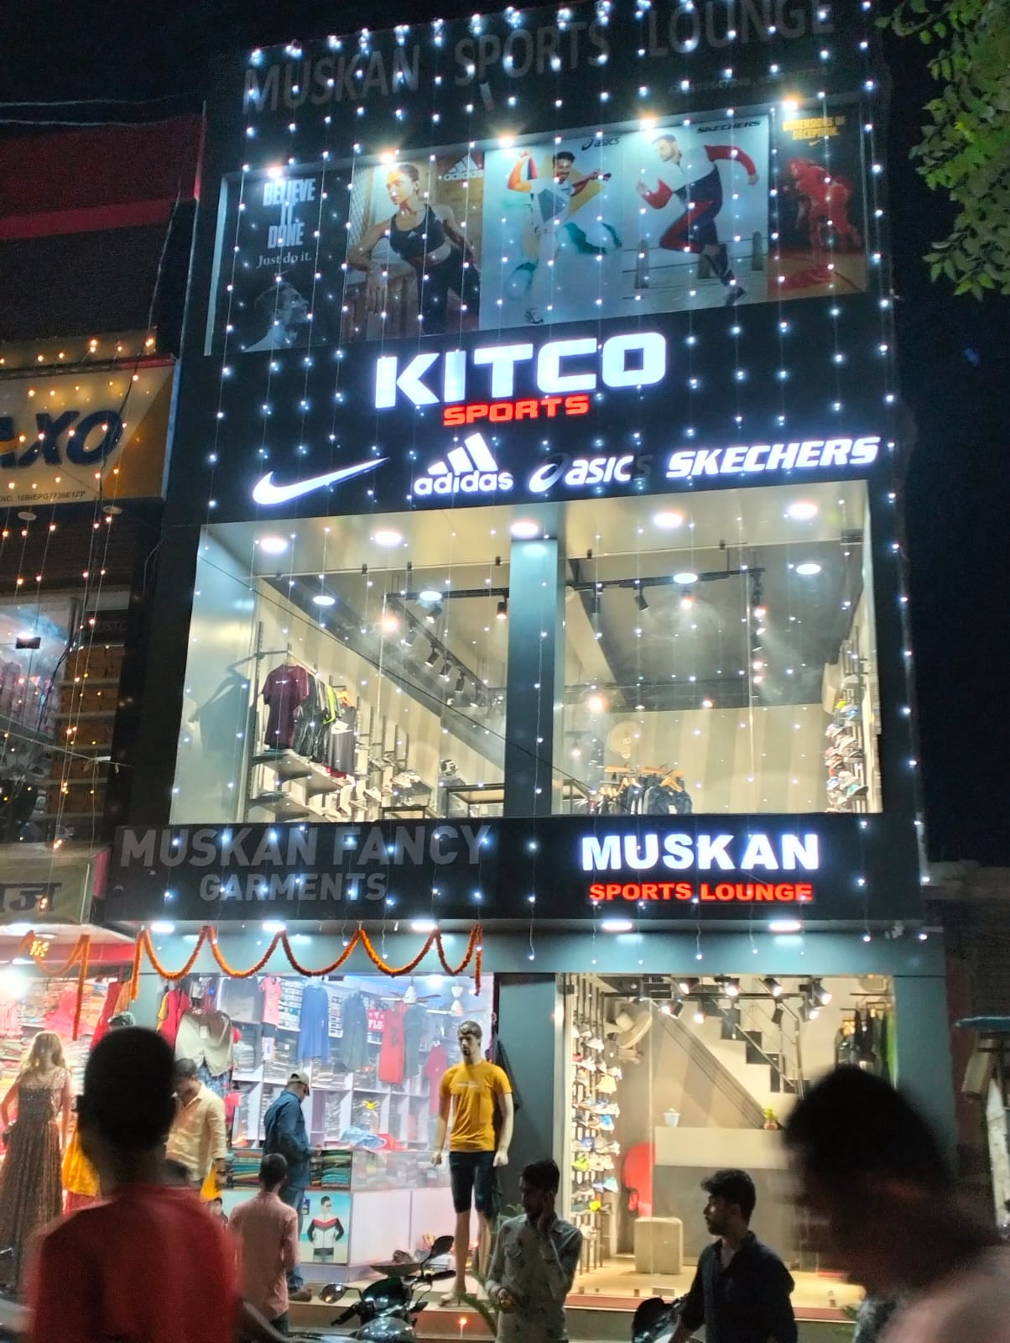
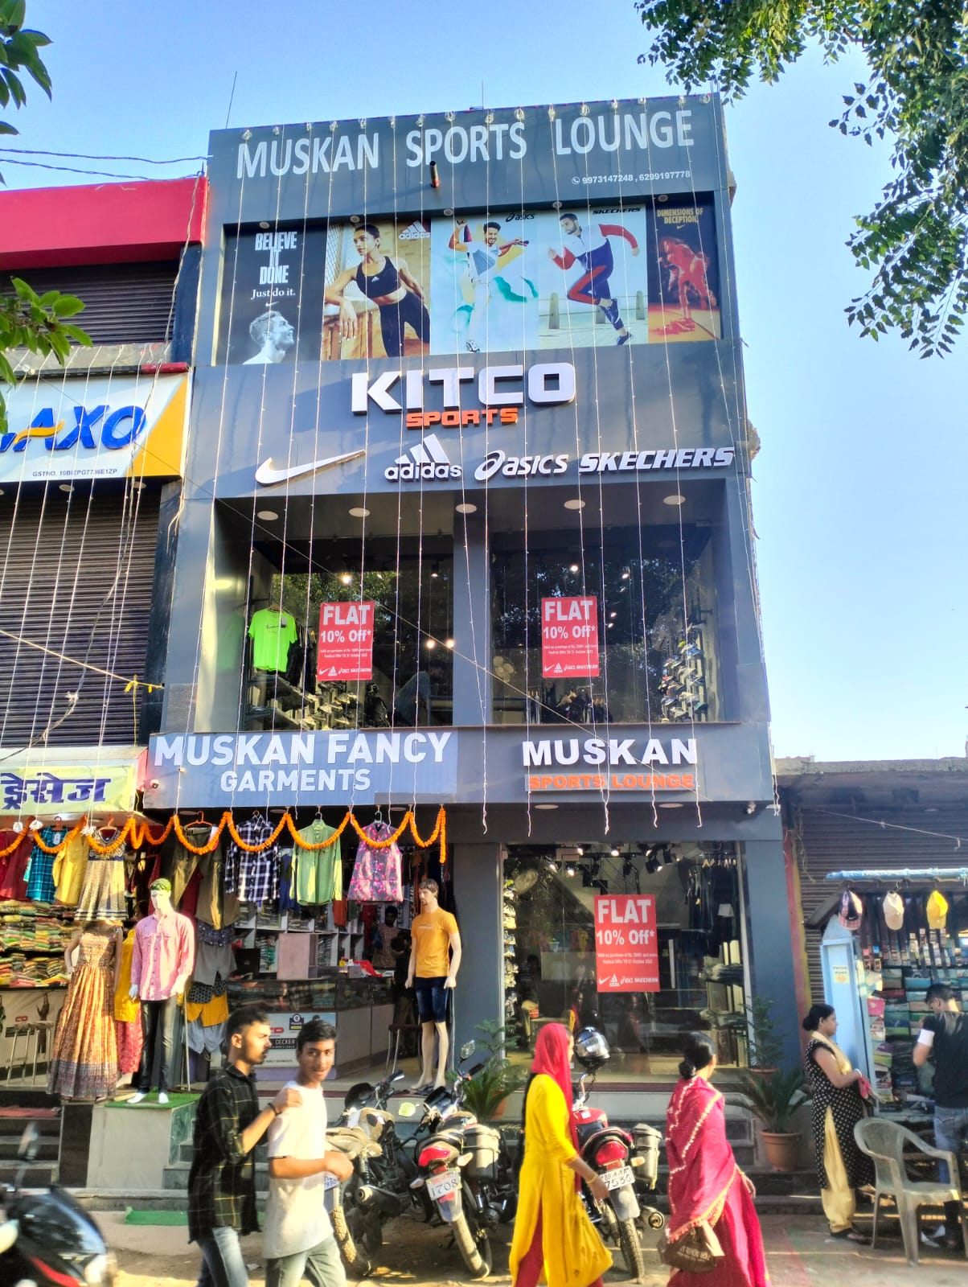
Buxar - Bihar

Slide 10
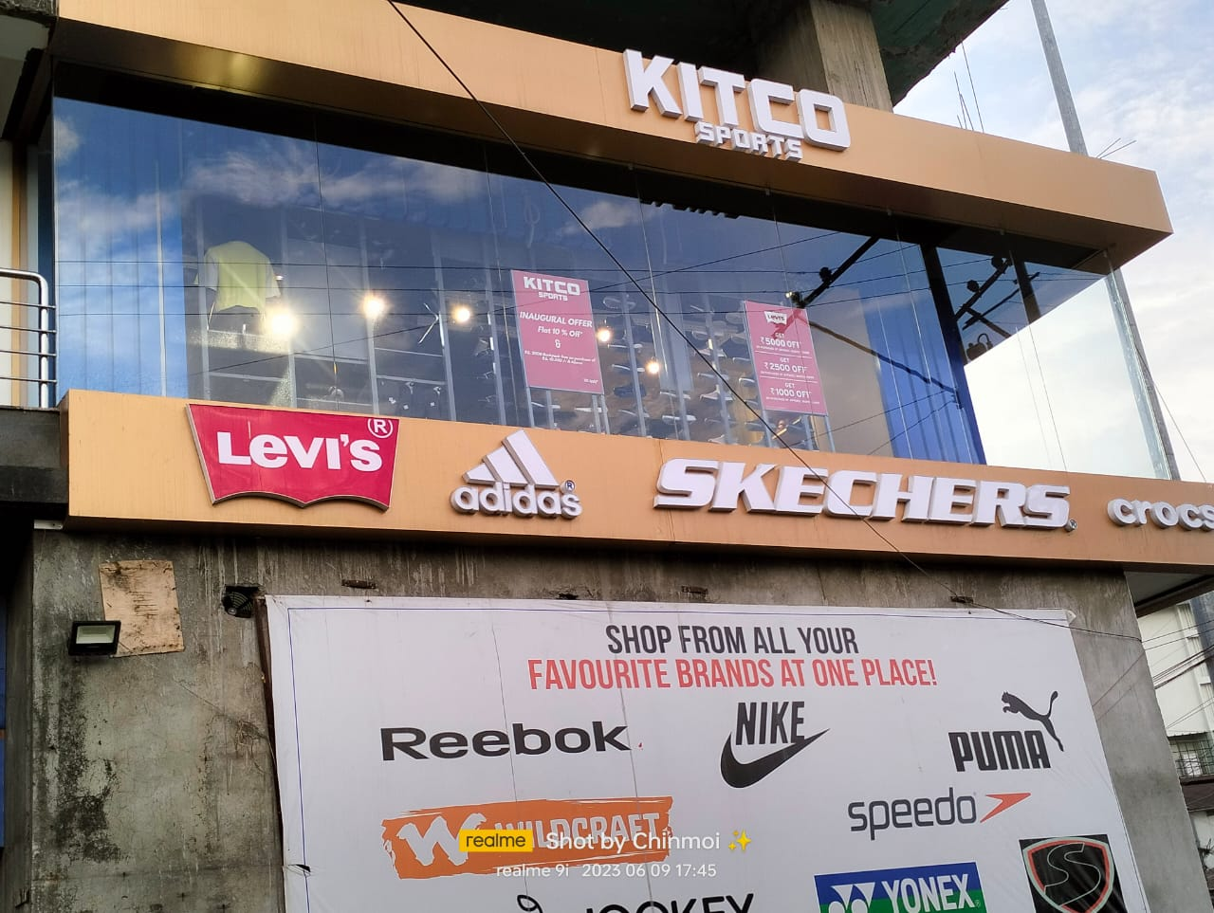
KITCO – Tezpur

Slide 11
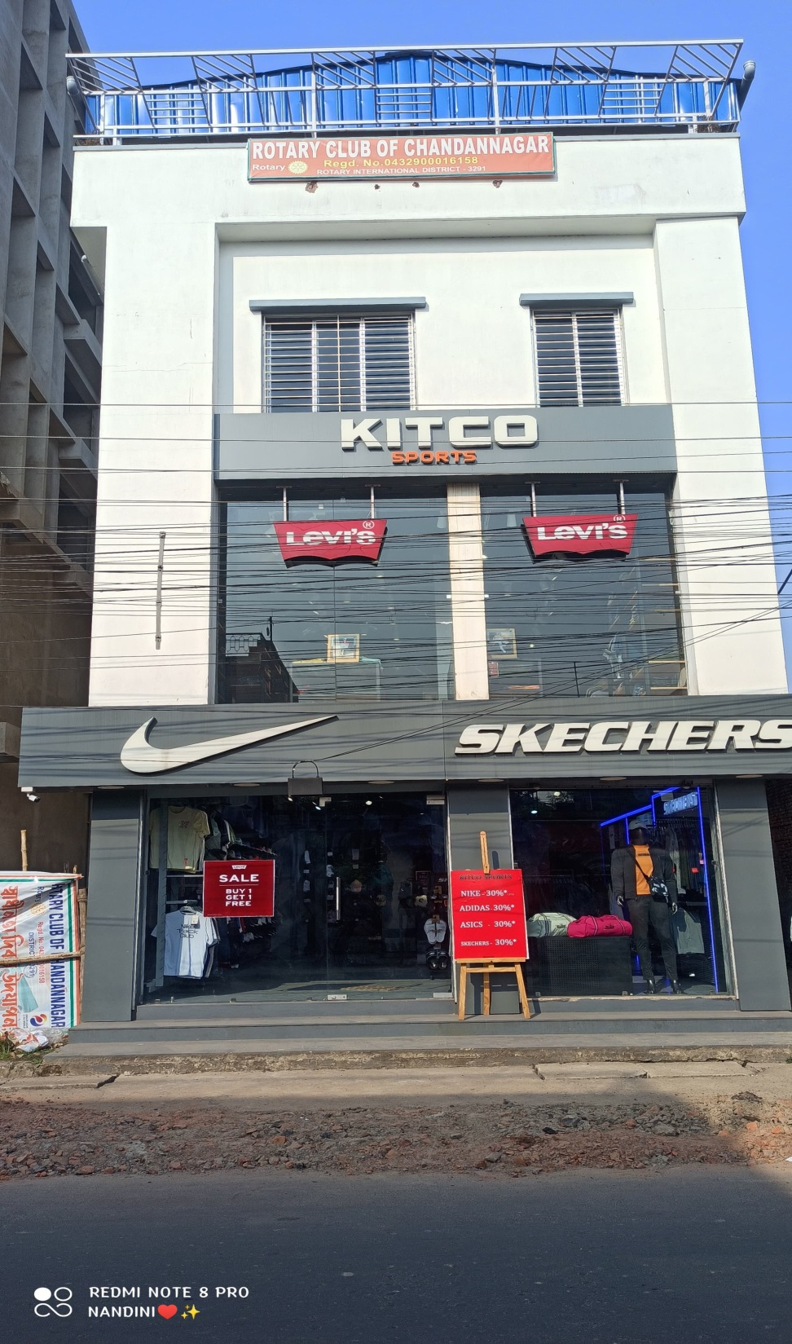
KITCO – Chandanagar - Bengal

Slide 12
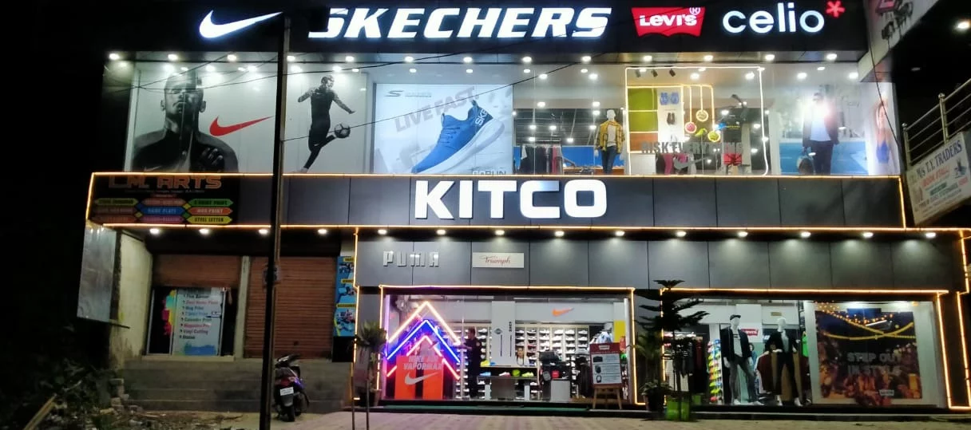
KITCO - ITANAGAR

Slide 13
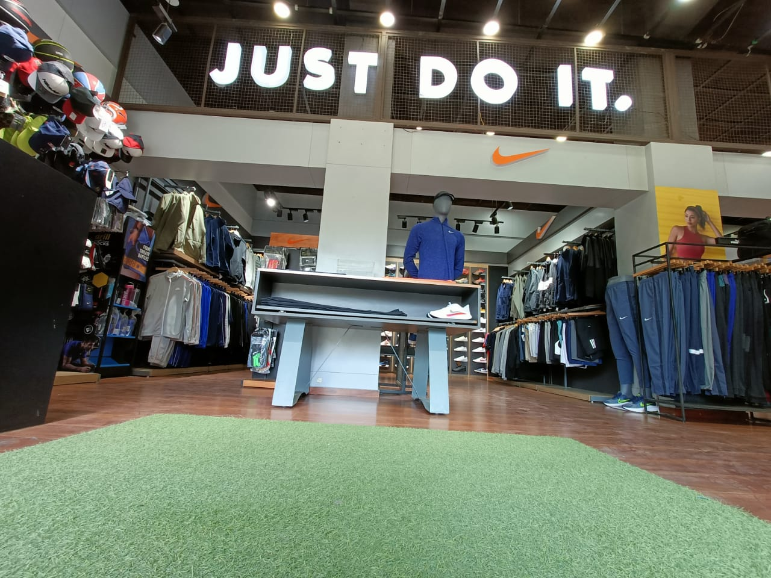
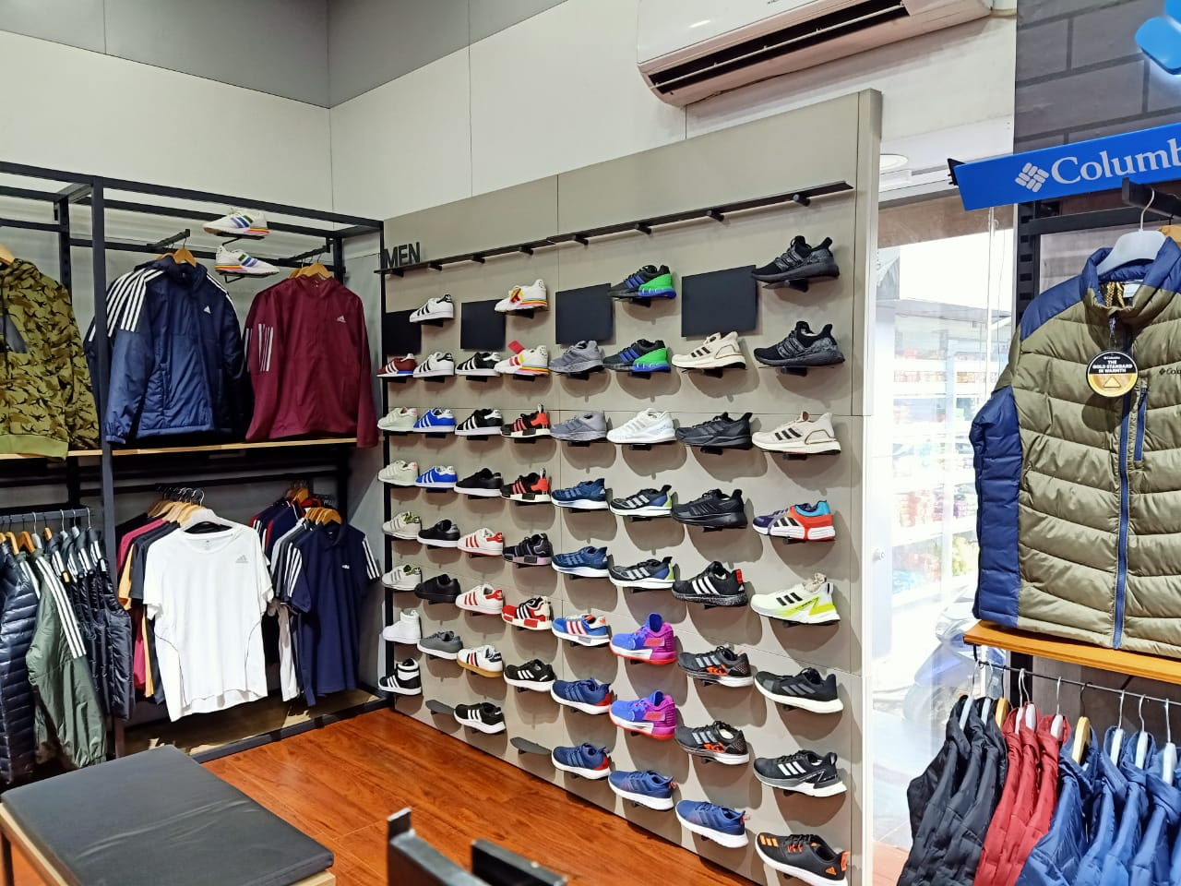
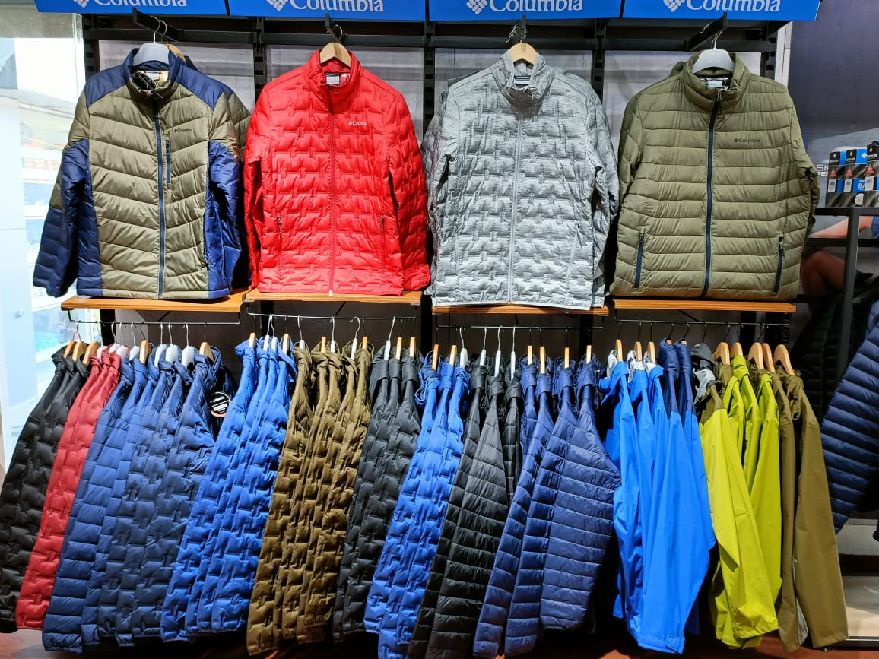
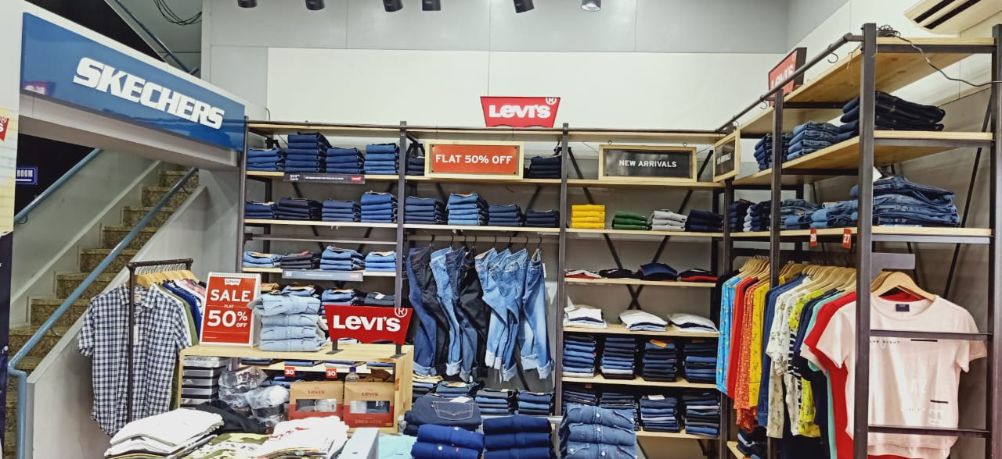
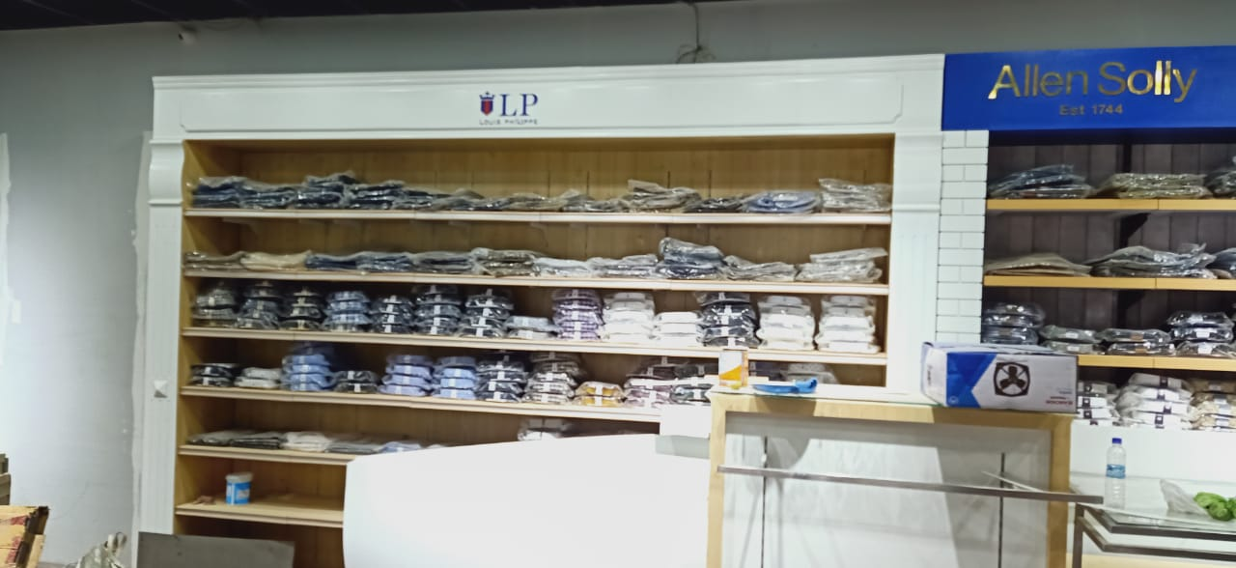
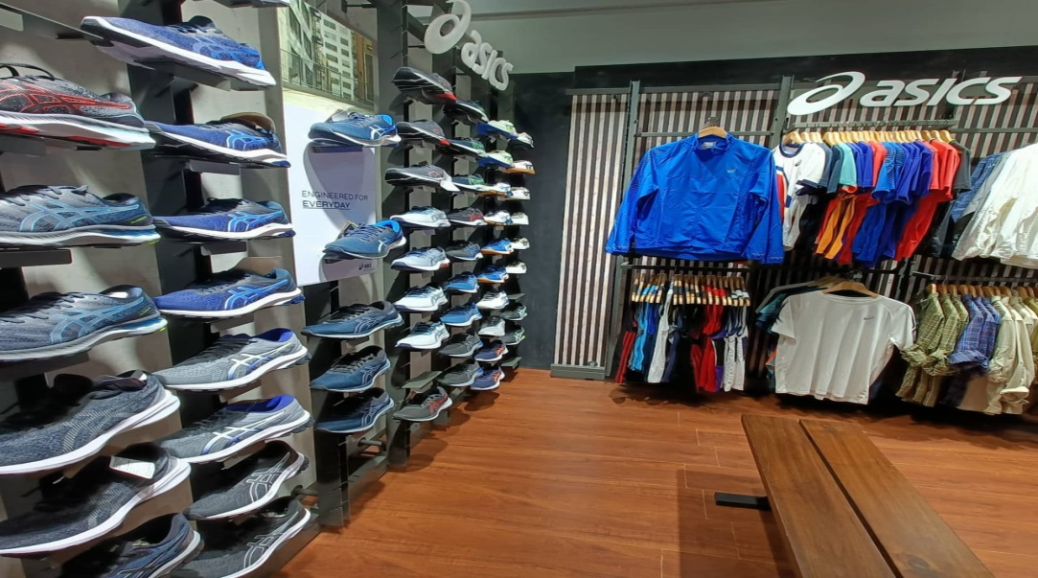

Slide 14
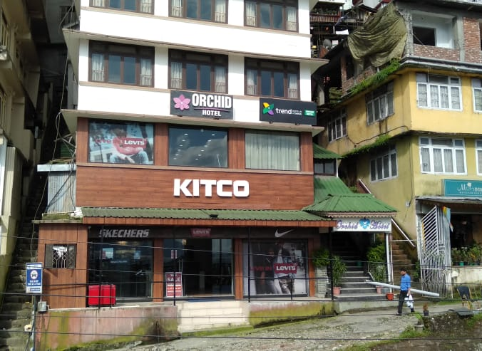
KITCO - GANGTOK

Slide 15
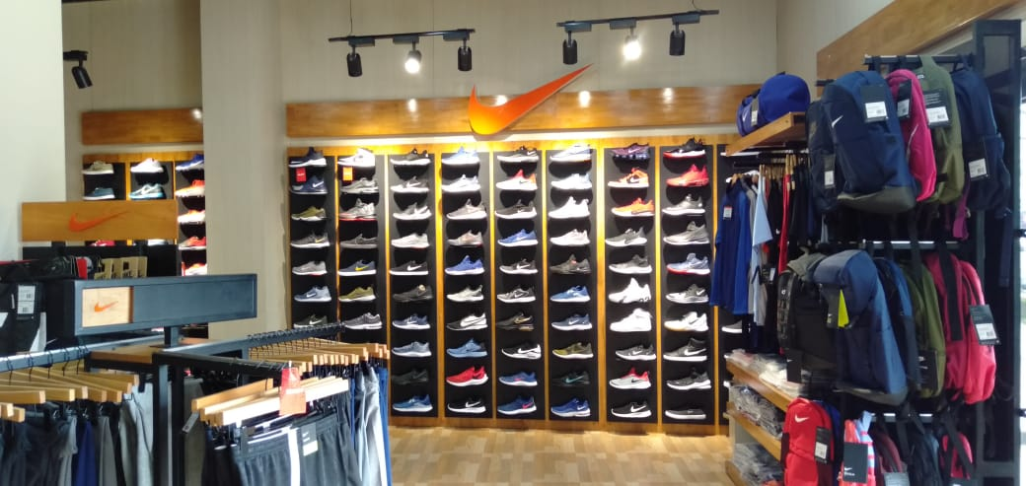
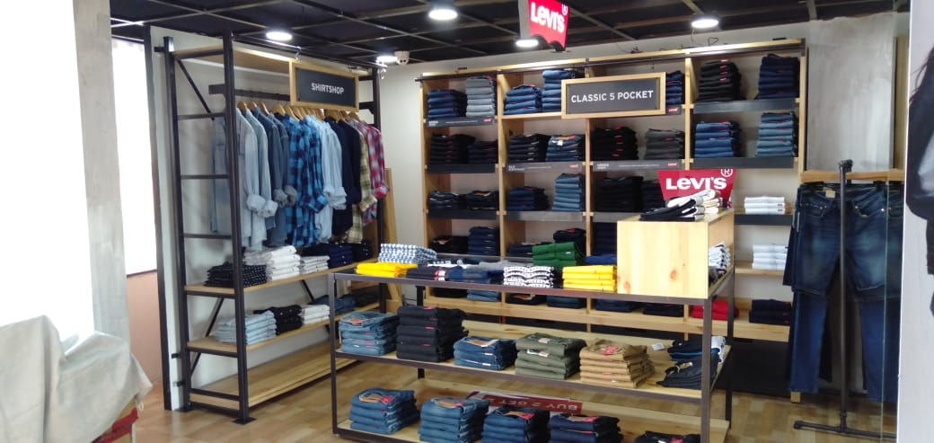
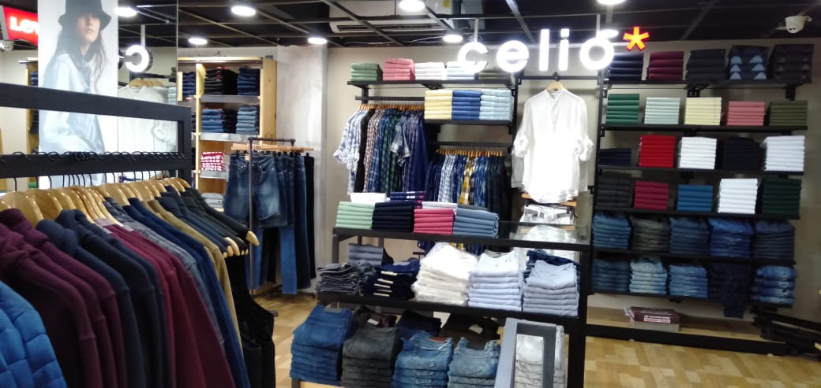
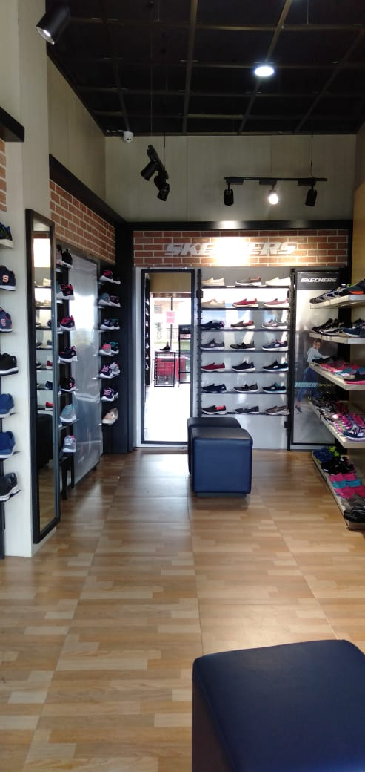
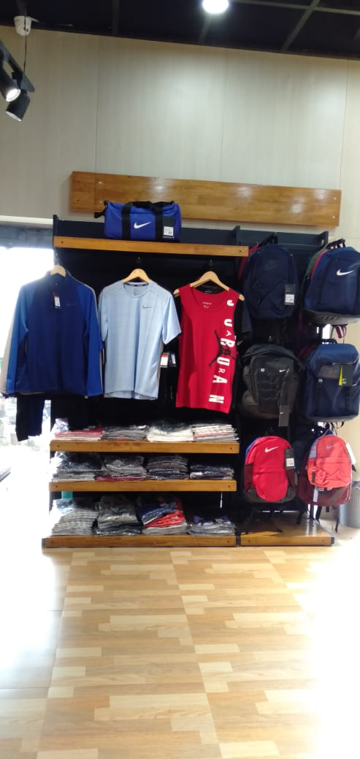
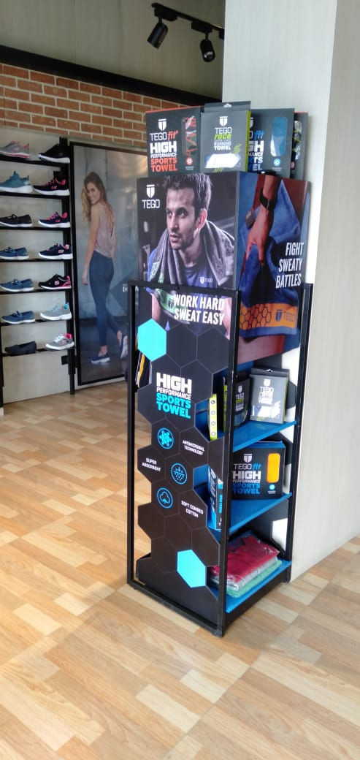
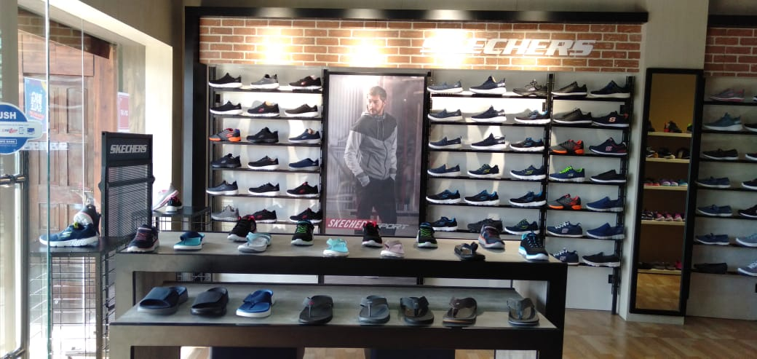

Slide 16
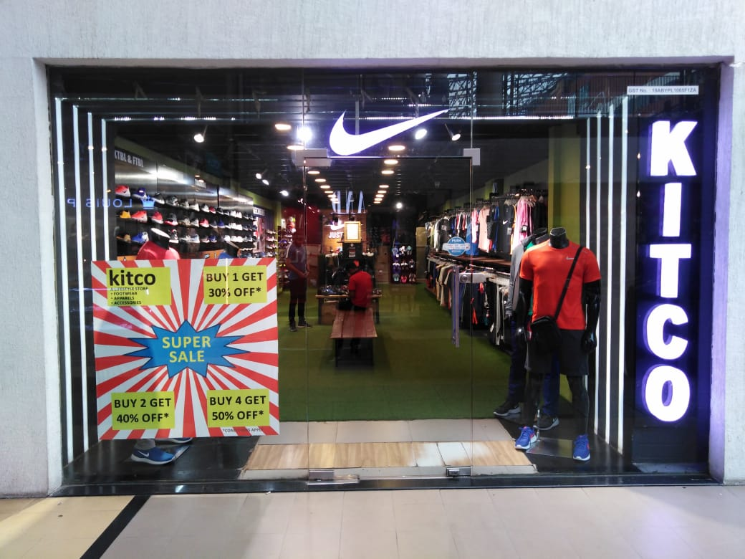
City Centre Mall Silliguri

Slide 17
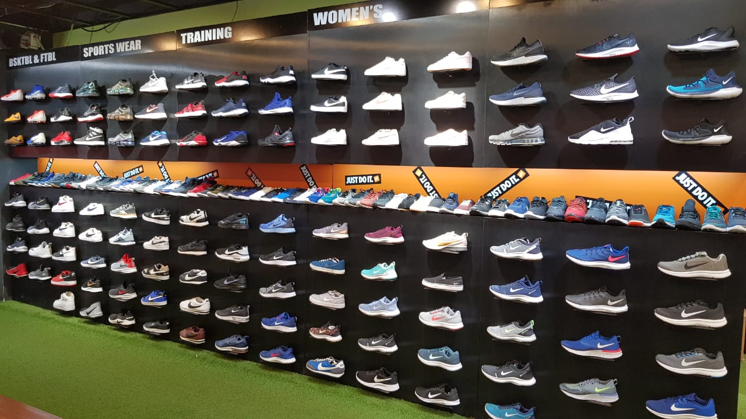
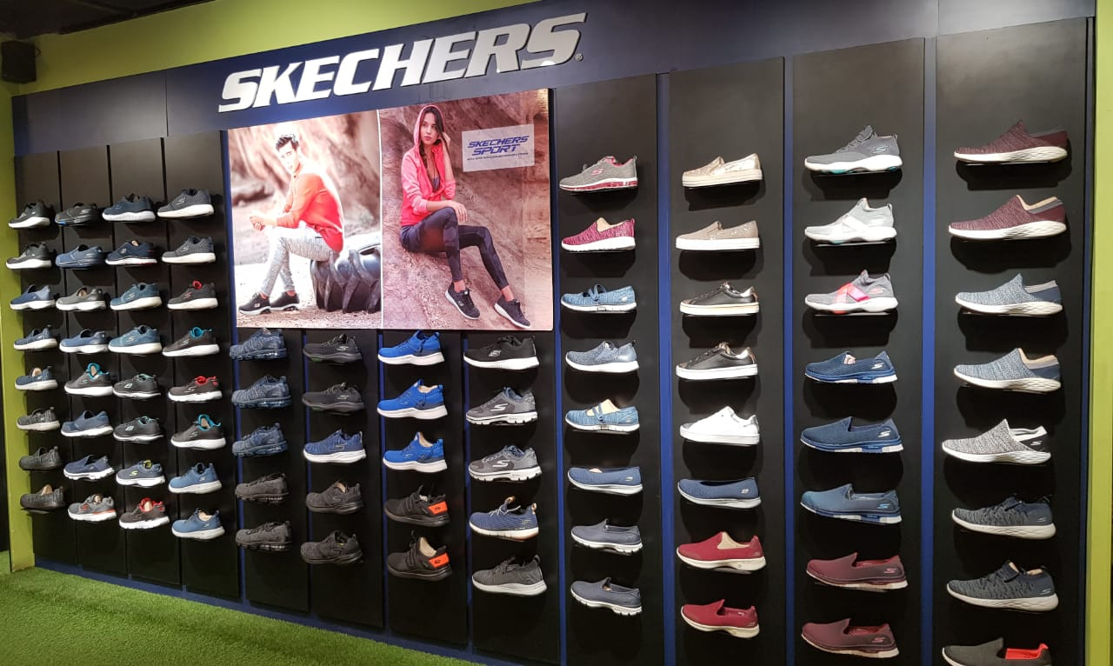
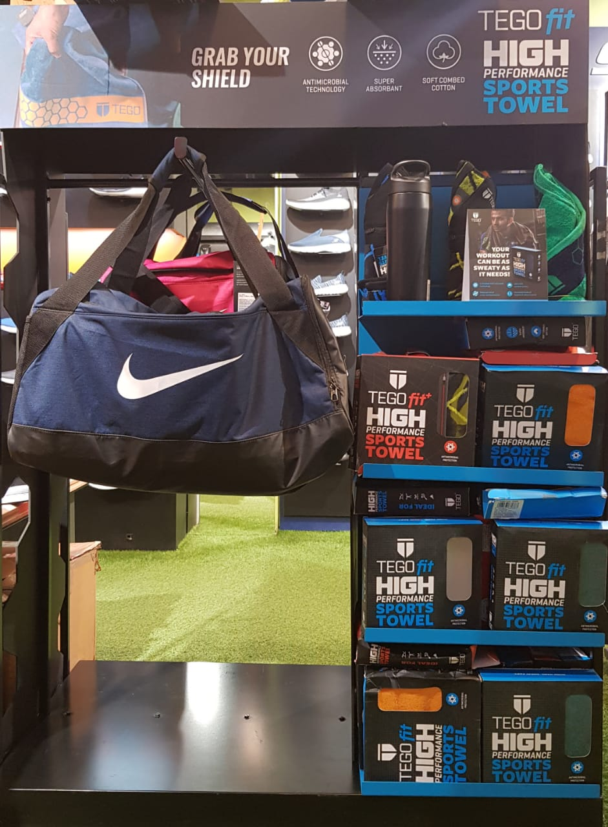
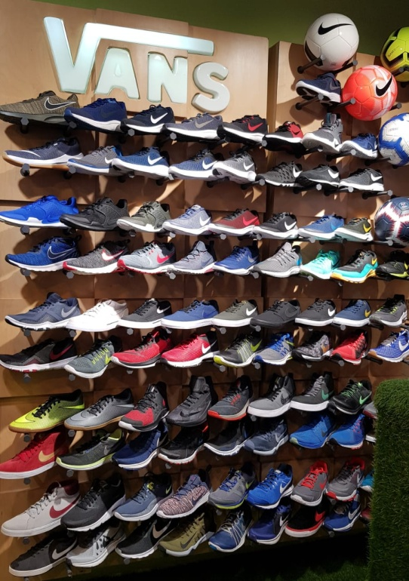
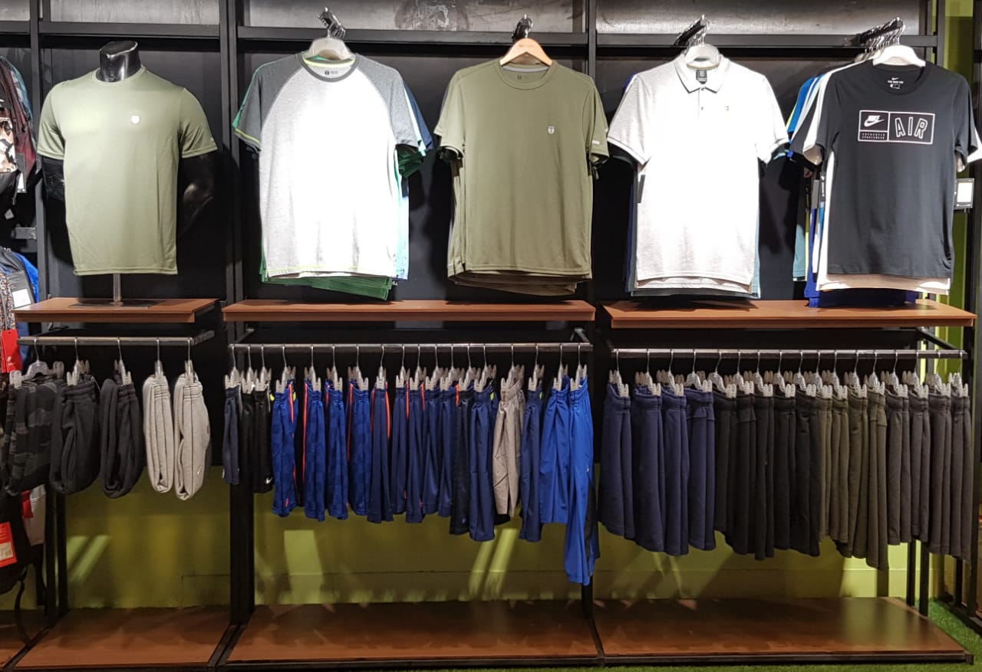

Slide 18
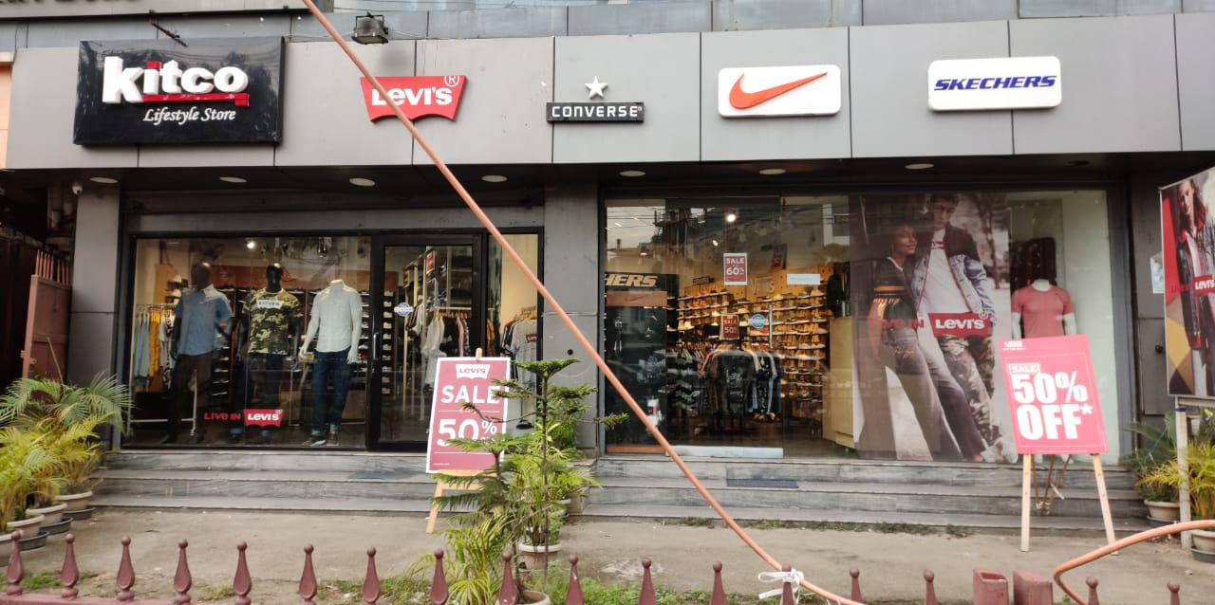
KITCO - GUWAHATI

Slide 19
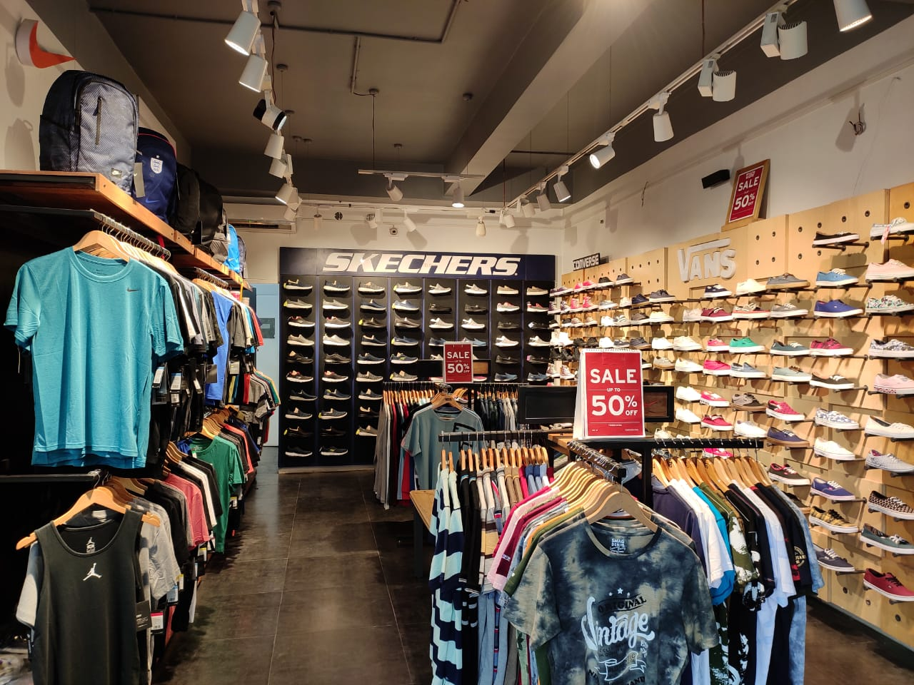
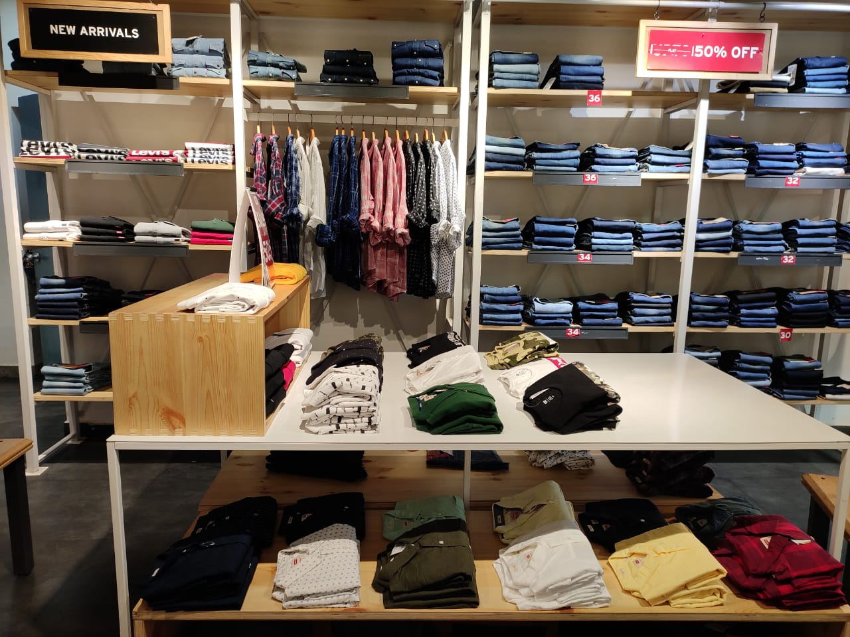
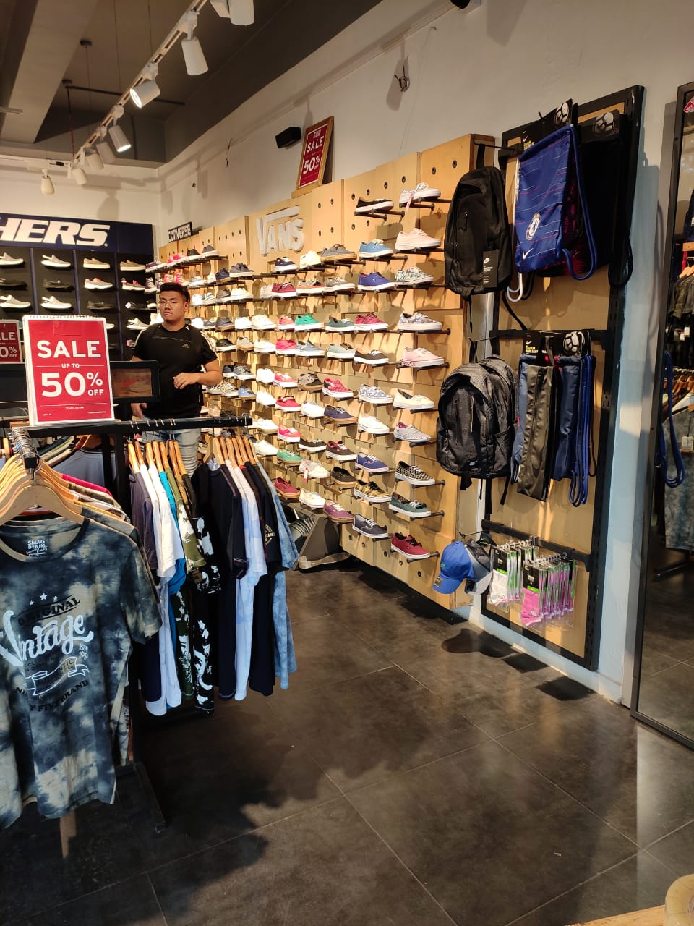
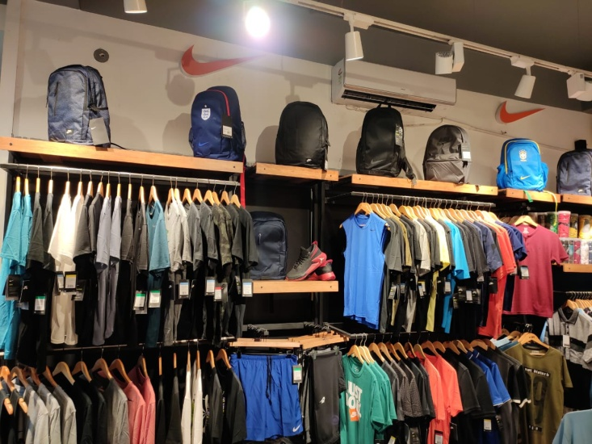
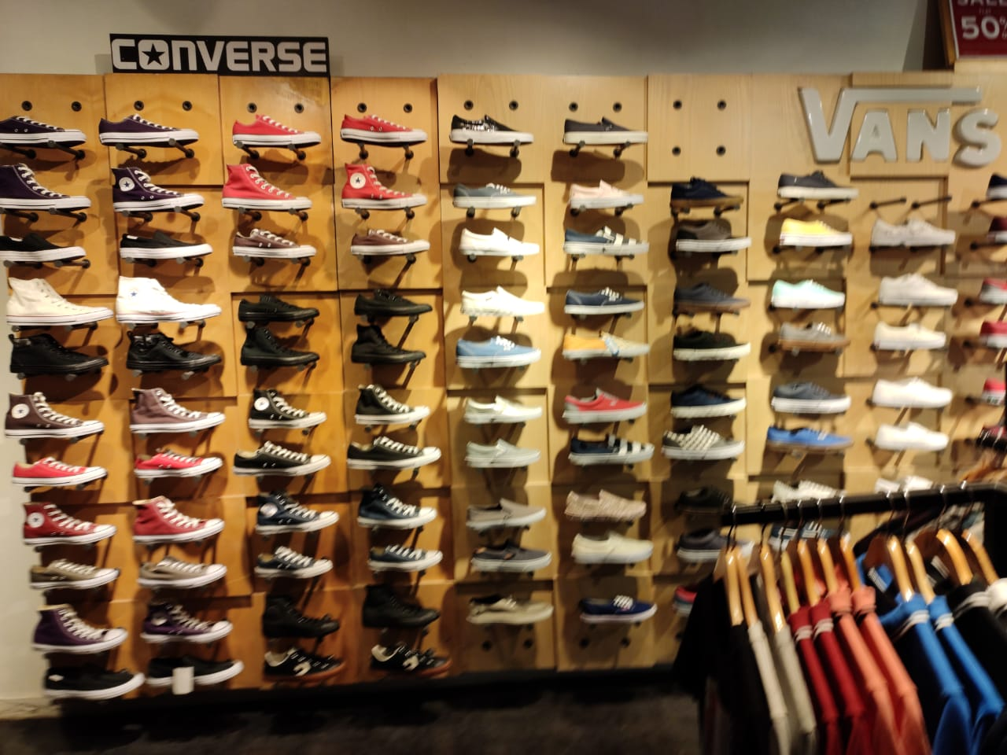

Slide 20
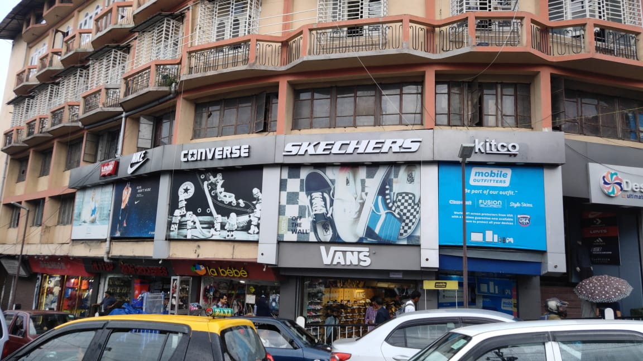
KITCO - SHILLONG

Slide 21
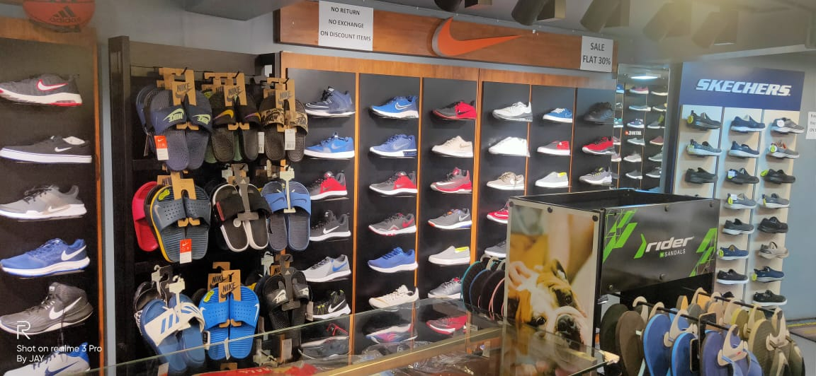
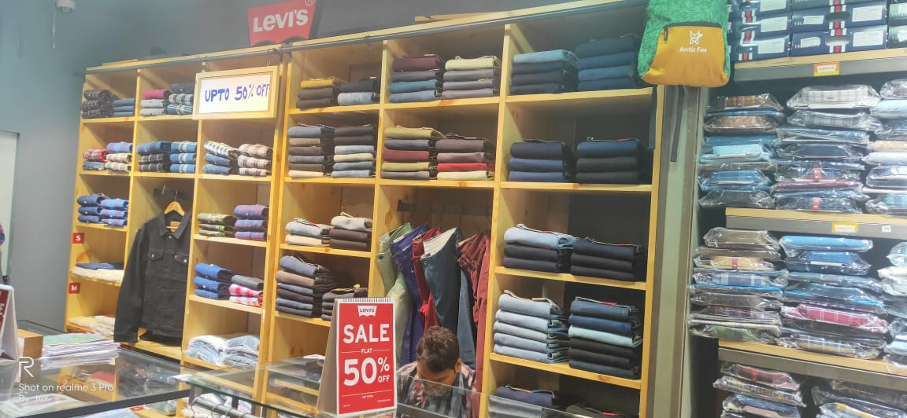
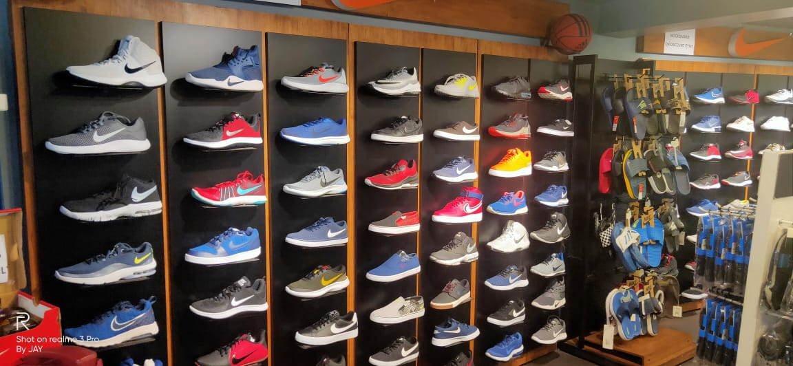
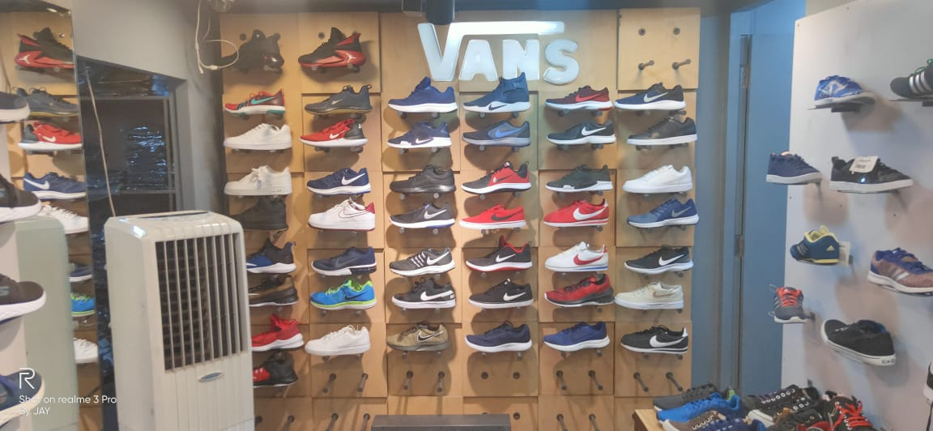
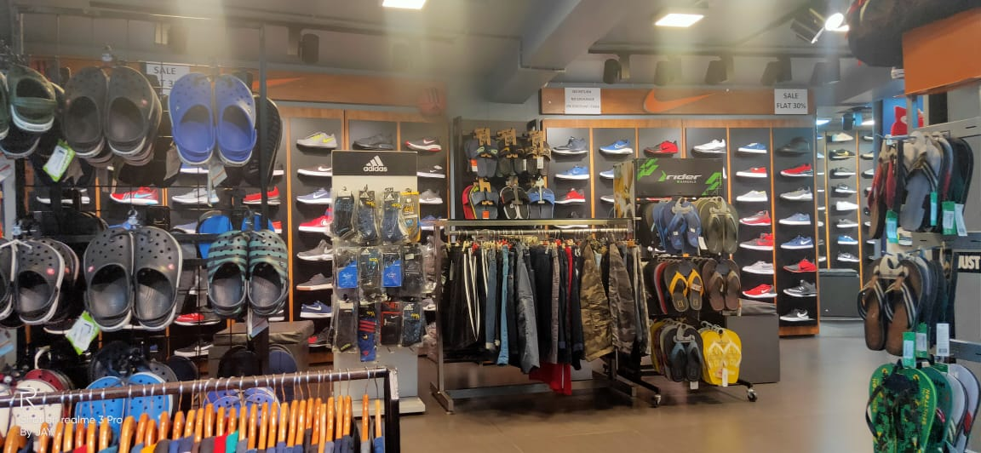
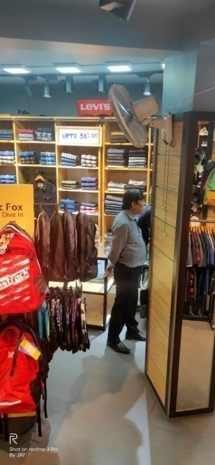

Slide 22
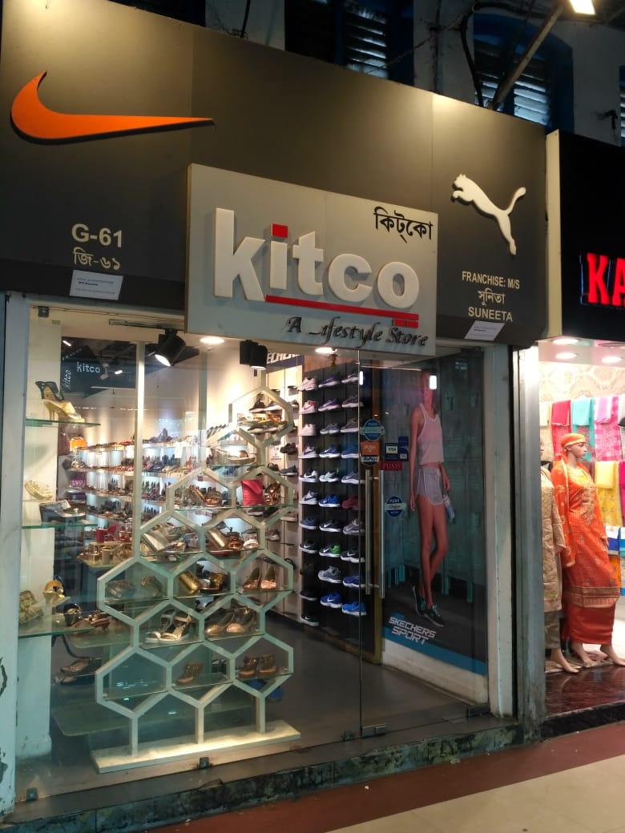
KITCO – LINDSAY STREET KOLKATA

Slide 23





Slide 24

IMPHAL

Slide 25





Slide 26

AIZAWL

Slide 27




Slide 28

DUMKA

Slide 29

Ranchi – GEL Church

Slide 30
City Centre Mall Silliguri

Slide 31
KITCO – LINDSAY STREET KOLKATA

Slide 32

KITCO City Centre Guwahati
KITCO City Centre Guwahati

Slide 33

KITCO ABC Plaza-Guwahati

Slide 34



KITCO Naharlagun

Slide 35

KITCO Grand Hotel, Kolkata

Slide 36

KITCO Gariahat Hotel, Kolkata

Slide 37

Frazer Road Patna – NIKE by KITCO

Slide 38

Bi-Brand Stores by KITCO

Slide 39

Bentinck Street Kolkata

Slide 40

City Centre – Patna – Nike Store

Slide 41



Slide 42


Raipur – KICK SPORTS

Slide 43


Kanchrapara – Bengal – KITCO SPORTS

Slide 44

Nike & Asics – Bi Brand Store at Forum Mall, Kolkata

Slide 45


BBSR- Patia-KITCO Store

Slide 46




Slide 47

Upcoming, Itanagar – Cibil Secretariat

Slide 48



Upcoming, Patna – Aashiyana More

Slide 49



Barasat, Kolkata
KICK SPORTS

Slide 50

Upcoming, Kalambagh, Muzaffarpur

